Slide 1

SUPPLY CHAIN ANALYSIS
GROUP - 06
ABHISHEK UDANSHIV
ARYAN ALPESH AGARWAL
CHAEYA LEE
HANEELA REDDY AVUTHU MANAS GARG
SMRUTI JAGDISH JADHAV

Slide 2
AGENDA
Introduction
Dataset Explanation
Recommenda-
tions
Research Questions
Conclusion
Future
Steps

Slide 3

INTRODUCTION
Background & Objective:
A large transactional dataset from retail business
Customer behavior
Fraudulent activities
Sales trends
Statistical analysis and machine learning techniques.
Expected Outcome:
Targeted marketing for each segment
Fraud prevention strategies
Accurate sales forecasting
Support data-driven decision-making in operations, finance, and customer relations.
Notes:
q

Slide 4
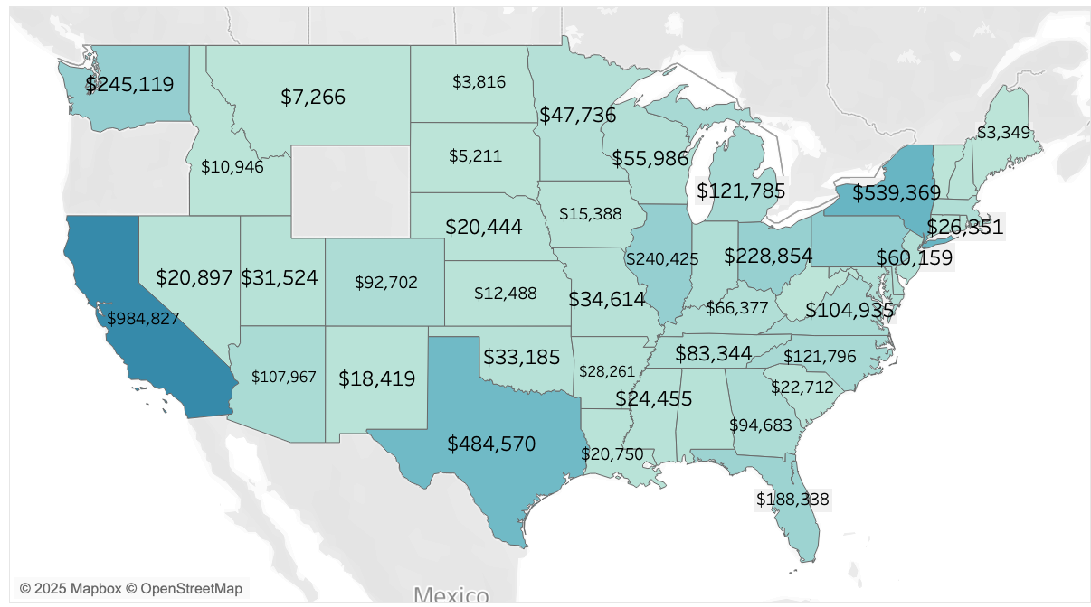
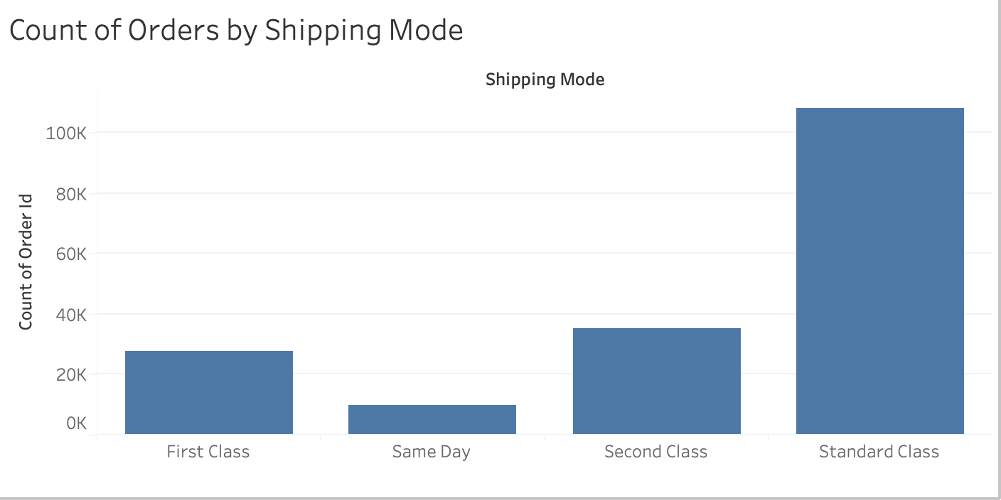
DATASET EXPLANATION
The Dataset is obtained from Mendeley Data
Company Name : DataCo
It consists of approximately 180,000 rows and 53 columns

Slide 5

RESEARCH QUESTION #1
How can we segment customers based on their purchasing behavior,shipping preferences, and order history?

Slide 6


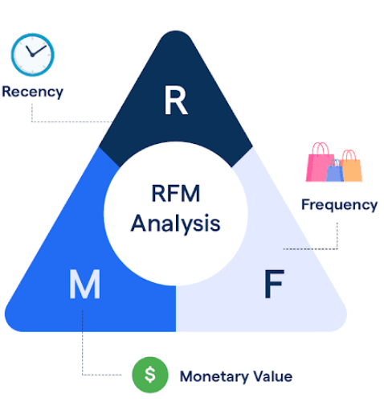


DATA PREPROCESSING
Data Type Conversion
Data Subsetting
Column Standardization
Normalizing with Minmax()
Recency, Frequency, Monetary Data Splitting
Notes:
In this phase, we prepared our data for analysis. First, the dataset was loaded, and we standardized the column names. We then focused on the most relevant data for customer behavior, shipping preferences, and order history. Next, we converted order dates to datetime format. Finally, we calculated RFM metrics: Recency, by finding the days since each customer's last order; Frequency, by counting their orders; and Monetary value, by summing their total sales. This resulted in a new dataset with Recency, Frequency, and Monetary values for each customer."

Slide 7
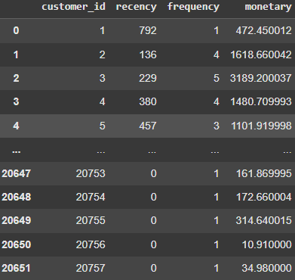
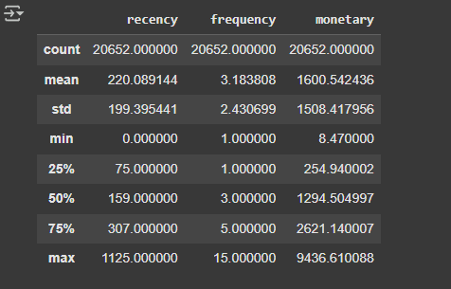
DATASET EXPLANATION
RFM Feature Summary:
Recency: Avg = 220 days, Range = 0–1125
Frequency: Avg = 3 orders, Max = 15
Monetary: Avg = $1600, Max = $9436

Slide 8
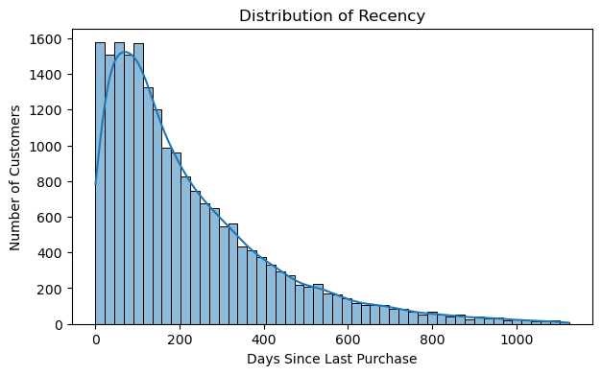
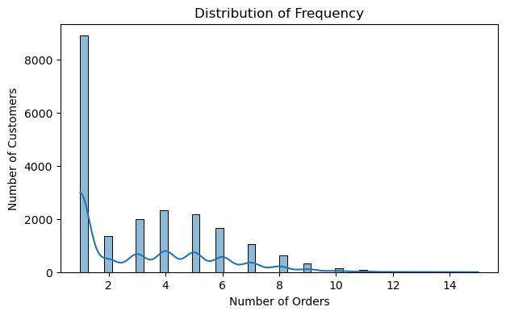
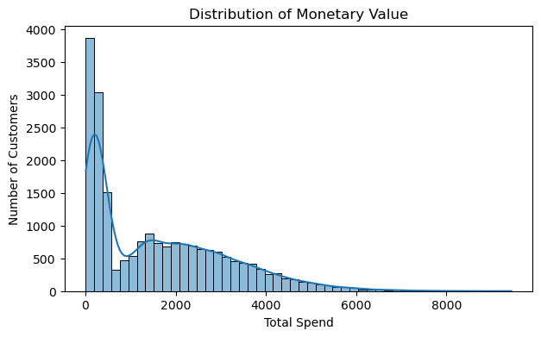
RFM ANALYSIS
Recency: Most customers purchased recently; activity declines sharply over time.
Frequency: Majority of users placed only 1–3 orders, indicating low repeat behavior.
Monetary: Spending is skewed — a few customers account for high revenue.

Slide 9
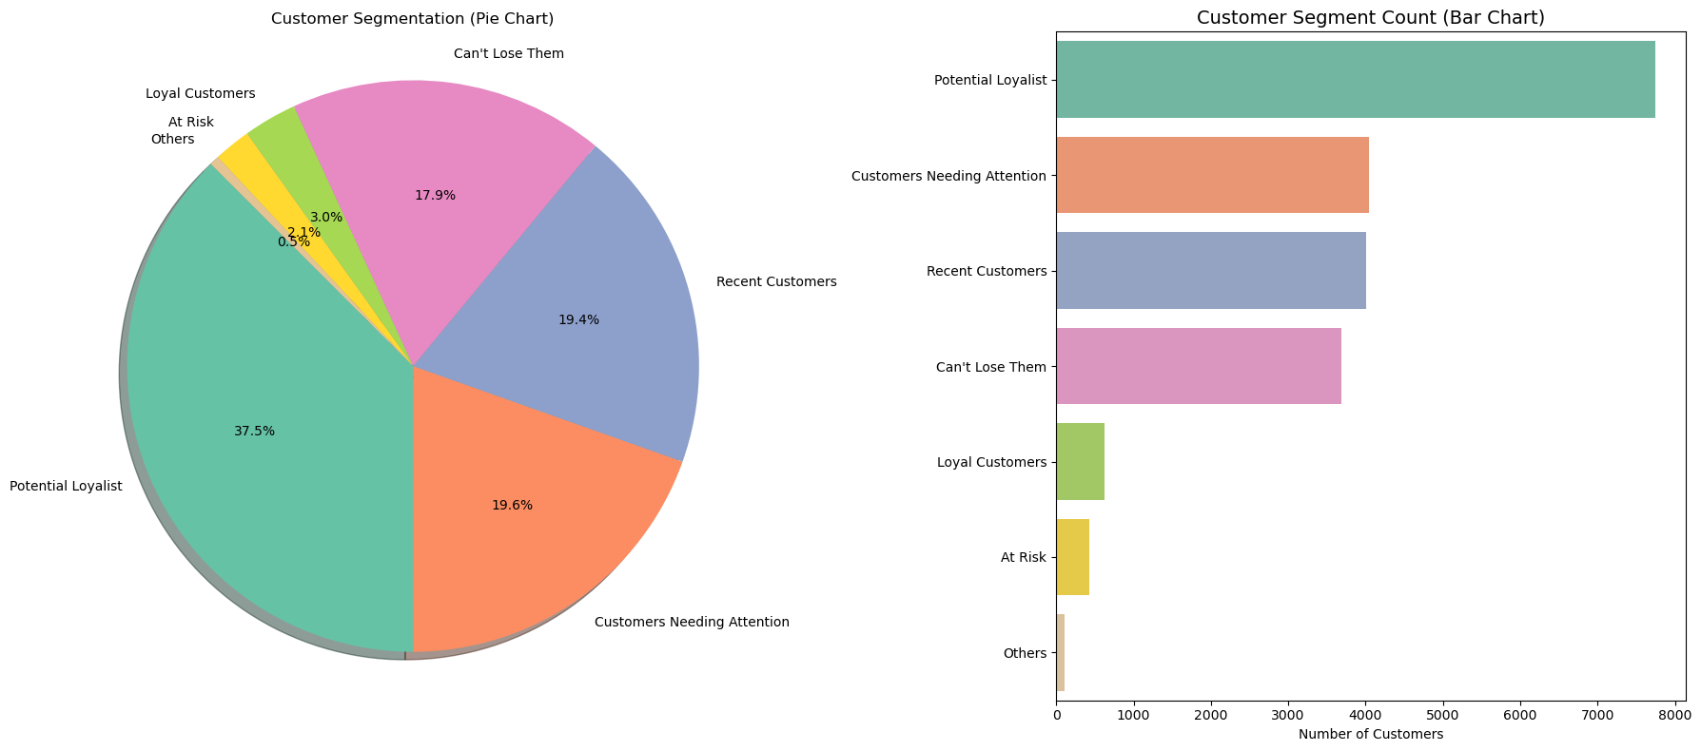
SEGMENTATION
Approach:
Customers scored on RFM (Recency, Frequency, Monetary) metrics using quantile-based binning.
Combined RFM scores used to classify customers into 8 named segments:
Champions, Loyal, Potential, Recent, Needing Attention, At Risk, Lost, Others
Most Common Segments:
Potential Loyalist (7,745)
Customers Needing Attention (4,041)
Recent Customers (4,012)

Slide 10
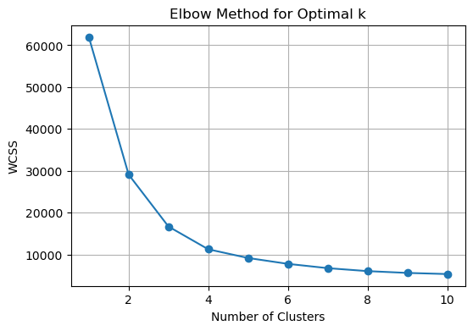
MODELING: OPTIMAL NUMBER OF CLUSTERS
Elbow Method Summary:
Evaluated K values from 1 to 10 using WCSS (Within-Cluster Sum of Squares)
Sharp drop observed until k = 4, after which the curve flattens
Selected 4 clusters as the optimal trade-off between performance and complexity
Visual Insight:
Elbow curve clearly shows diminishing returns after 4 clusters

Slide 11
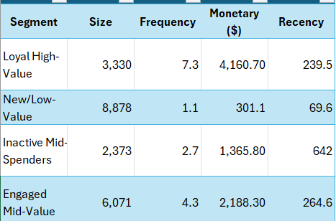
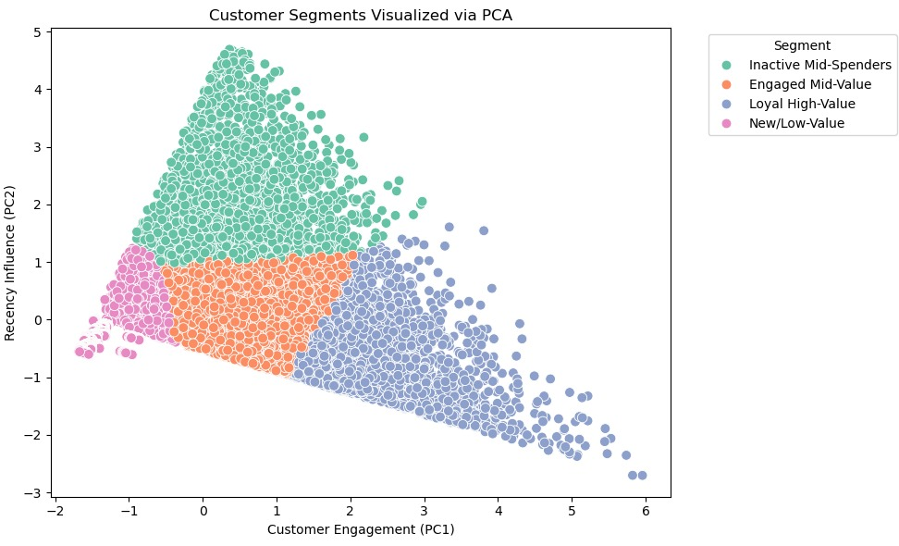
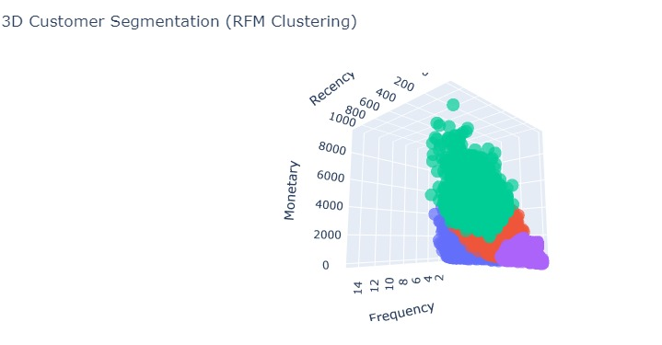
CUSTOMER SEGMENT INSIGHTS
Visual Summary:
PCA plot shows clean separation across 4 customer profiles.
Clusters vary in size, spending potential, and engagement behavior.

Slide 12

RESEARCH QUESTION #2
Can we predict future sales based on past transaction data, seasonality, and regional sales trends?

Slide 13
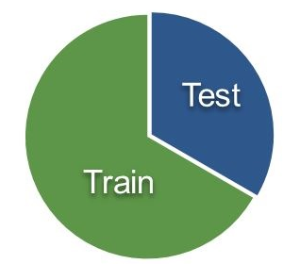
DATA PREPROCESSING
Converted order date to datetime
Aggregated daily sales
Null Values Removed
Reindexed missing dates
Splitting Data (Time Dependent)
Notes:
Synthetic Minority Oversampling Technique (SMOTE) is a statistical technique for increasing the number of cases in your dataset in a balanced way. The component works by generating new instances from existing minority cases that you supply as input. This implementation of SMOTE does not change the number of majority cases.

Slide 14
MODEL BUILDING
Used models: Naive Forecasting, Moving Average, Simple Exponential Smoothing, ARIMA, Univariate LSTM, Multivariate LSTM, Stacked LSTM, Ensemble Forecasting.
Evaluated with metrics: RMSE, MAE.
Hyperparameter tuning using ARIMA orders (p, d, q), LSTM architecture (layers, units, dropout).
Validation approach: Train/validation/test splits, early stopping, residual diagnostics.

Slide 15
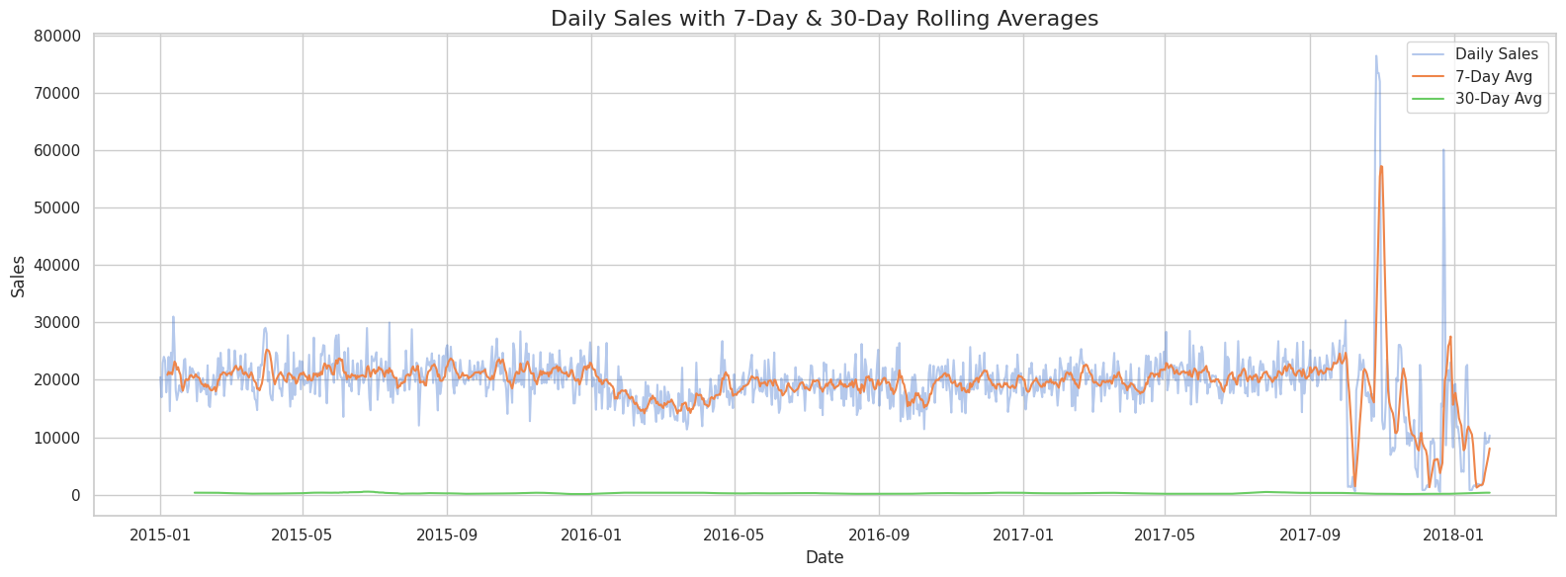

Slide 16
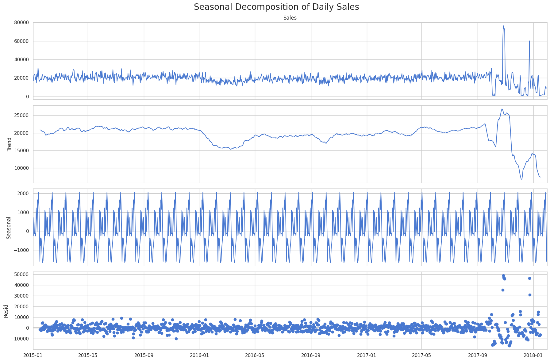

Slide 17
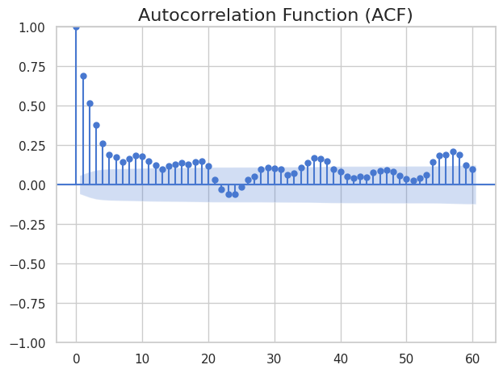
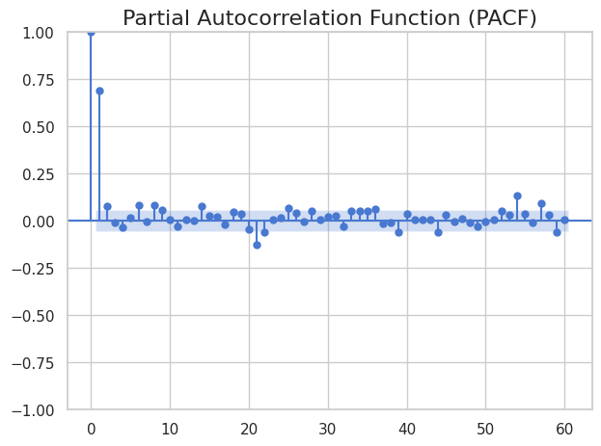

Slide 18
BASELINE MODELS
1. Naïve Forecast
Predicts next day’s sales as today’s value
RMSE: 7,534.70, MAE: 3,978.51
Surprisingly effective due to stable short-term sales before 2017
2. Moving Average (7-Day)
Uses mean of past 7 days for prediction
RMSE: 11,891.98
Failed to capture sudden drops and spikes; oversmooths
3. Simple Exponential Smoothing (SES)
Models short-term level without trend or seasonality
RMSE: 12,035.98
Slightly worse than moving average due to lack of adaptability
Key Takeaway:
These baseline models performed reasonably during stable periods

Slide 19
ARIMA - AutoRegressive Integrated Moving Average
Input: 45-day sliding window of past sales
Data scaled using MinMaxScaler
Architecture: LSTM → Dropout → Dense
Trained on 80% data with early stopping
Model Performance:
RMSE: 12,049.21
MAE: 7,680.37

Slide 20
UNIVARIATE LSTM
Scaled sales values using MinMaxScaler
Created 45-day sliding windows for input sequences
Built LSTM → Dropout → Dense model
Trained using 80:20 split and tracked loss/validation loss
Model Performance:
RMSE: 11,201.60
MAE: 6,895.11

Slide 21
MULTIVARIATE LSTM
Added time-based (day, month) and lag-based features
Trained LSTM on multivariate sequences
No improvement in prediction accuracy by modeling feature dependencies
Model Performance:
RMSE: 11,829.26
MAE: 7,252.62

Slide 22
STACKED LSTM
Engineered features: Lag1, Lag2, 3-day MA, 7-day MA, Day, Month, Year
Used stacked architecture: LSTM (64) → LSTM (32) → Dense
Train/val/test split: 70/10/20
Trained for 30 epochs with dropout for regularization
Early stopping stabilized training and restored the best-performing weight.
RMSE: 11,523 and MAE: 7,179

Slide 23
ENSEMBLE
= LSTM + Naïve Ensemble Forecast
LSTM's ability to capture temporal patterns + Naïve model’s short-term accuracy
🧮 Formula:
y_ensemble = α × y_pred_lstm + (1 - α) × y_pred_naive
α = 0.6
Gave the LSTM model 60% of the weight and the naïve model 40%.
Reduced RMSE to 8,513 and MAE to 5,410

Slide 24
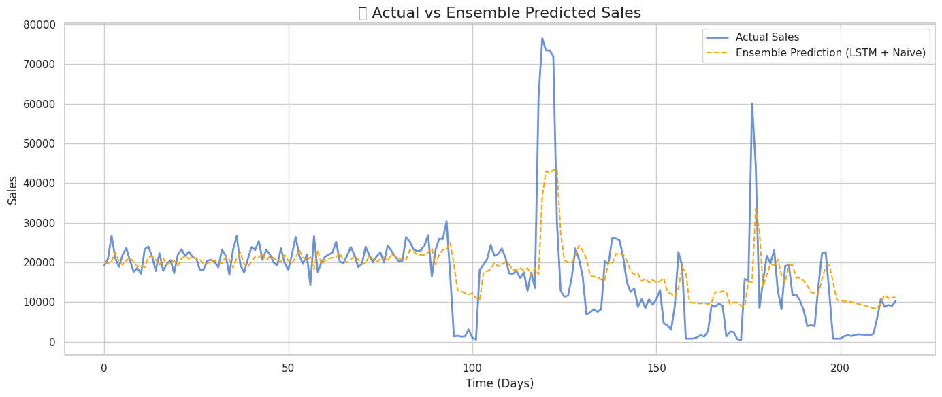
ENSEMBLE LSTM

Slide 25
RESULTS & EVALUATION
Model performance heavily impacted by data imbalance
Sudden, extreme sales spike in mid-2017 caused inflated RMSE across all models
Models predicted well during normal periods but failed to capture post-spike volatility
RMSE not a fair sole metric in this case
High RMSE ≠ poor model, but rather reflects extreme variance and anomalies
MAE offers better stability and interpretability in this case
Best Model:
Ensemble (LSTM + Naïve)
RMSE: 8,513.25, MAE: 5,409.59
Balanced between overfitting and underfitting
Key Insight: Forecasting performance can only be as good as the stability and representativeness of the data.

Slide 26

RESEARCH QUESTION #3
Can we identify fraudulent transactions based on order patterns, payment types, and late delivery risks?
Notes:
In today’s digital economy, fraud detection is both a financial and reputational necessity.
We aimed to explore whether structured transaction data could be leveraged to predict fraud reliably.
Specifically, we focused on features like:
Order patterns — such as frequency, amount, and status
Payment types — including high-risk methods like wire transfers or prepaid cards
Late delivery risk indicators — which may hint at manipulation or avoidance tactics
Our goal was to use this data to train machine learning models that not only classify transactions as fraudulent or not but do so with high precision and recall—especially for the minority fraud class.”

Slide 27
DATA PREPROCESSING
Null Values Removed
Splitting Data (Stratified Split)
Handled Imbalanced Data
Using SMOTE
Encoding Categorical Variables (Ordinal Encoding)
Notes:
“Before training any machine learning models, we performed a thorough data preprocessing workflow to ensure the quality and reliability of our inputs.
First, we removed null values to eliminate incomplete records that could introduce bias or noise.
Next, we performed a stratified train-test split, ensuring that the fraud class distribution remained consistent across both sets—critical due to the heavy class imbalance.
To address this imbalance, we applied SMOTE—Synthetic Minority Over-sampling Technique—which generates synthetic fraud cases to help the model learn minority class patterns better.
We also encoded categorical variables using ordinal encoding, transforming features like payment type and order status into numeric form, suitable for model input.
Overall, these preprocessing steps were foundational in enabling our models to perform well, particularly in detecting the rare but high-impact fraudulent transactions.”
0 176457
1 4062
Synthetic Minority Oversampling Technique (SMOTE) is a statistical technique for increasing the number of cases in your dataset in a balanced way. The component works by generating new instances from existing minority cases that you supply as input. This implementation of SMOTE does not change the number of majority cases.
Without SMOTE:
A model could achieve 97%+ accuracy by predicting everything as non-fraud
But it would miss all fraud cases (low recall)
With SMOTE:
The model learns to detect fraud patterns better
Boosts recall and F1-score for the minority class (fraud)

Slide 28
MODEL BUILDING
Used models: Random Forest, XGBoost, LightGBM, CatBoost, ADABoost, Gradient Boost
Evaluated with metrics:
Recall: to measure how well the model detects actual frauds
F1 Score: which balances precision and recall for fraud detection
Accuracy (Generalisation): to assess overall performance and generalization to unseen data
Notes:
“For this project, we tested a variety of supervised machine learning models to identify fraudulent transactions effectively. The models used included:
Random Forest, XGBoost, LightGBM, CatBoost, AdaBoost, Gradient Boost
Each model was carefully evaluated using three key metrics:
Recall, to measure how well the model detects actual frauds
F1 Score, which balances precision and recall for fraud detection
Accuracy, to assess overall performance and generalization to unseen data
These metrics helped us identify which models not only performed well in general but were especially effective at capturing fraudulent behavior—our primary focus.”

Slide 29
NEURAL NETWORK MODELING INSIGHTS
Artificial Neural Networks (ANNs) using various hyperparameter tuning strategies, including:
Adding batch normalization and dropout layers
Adjusting % of Dropout Layers for regularisation / preventing our model from overfitting
Testing different optimizers and activation functions
CONCLUSION:
Despite extensive tuning, the model achieved a maximum of 97% accuracy & recall
Underperformed Baseline Model.
Notes:
Despite extensive tuning, the model achieved a maximum of 97% accuracy and recall, which underperformed compared to our baseline model —which simply predicted all transactions as non-fraud (class 0).
This highlighted that the ANN failed to effectively learn fraud patterns in the dataset.

Slide 30
MODEL COMPARISON
Model | Accuracy | ROC-AUC | Precision | Recall | F1
Random Forest | 0.9849 | 0.9873 | 0.9898 | 0.9948 | 0.9923
CatBoost | 0.9875 | 0.9895 | 0.991 | 0.9962 | 0.9936
ANN | 0.9531 | 0.9751 | 1 | 0.96 | 0.98
Notes:
“This table summarizes the detailed classification performance of the three models we evaluated: Random Forest, CatBoost, and the Artificial Neural Network (ANN).
For each model, we highlight precision, recall, and F1-score for both class 0 (non-fraud) and class 1 (fraud) to provide a complete picture of how well each model performed.
Starting with CatBoost—it achieved the highest overall accuracy (98.75%) and a recall of 99.62% for non-fraud cases, ensuring very few legitimate transactions were misclassified. Importantly, it also had the best balance of precision and recall for fraud, with an F1-score of 0.6852, making it the strongest overall model.
Random Forest followed closely, with slightly lower recall and F1-score for fraud. Still, it performed reliably and consistently.
ANN, while achieving a high recall of 81% for fraud, struggled with precision, resulting in a lower F1-score. This means it correctly flagged more fraud cases, but also raised many false alarms.
In conclusion, CatBoost emerged as the best model for our dataset, balancing fraud detection performance with minimal false positives and high general accuracy.”

Slide 31
RESULTS & EVALUATION
Recommendation:
Best Overall:
CatBoost — it has the highest balance of precision, recall, and F1-score, with outstanding accuracy.
Best Business-Friendly Tradeoff:
Random Forest — if you want strong performance across all metrics with simplicity and interpretability.
Notes:
We recommend CatBoost as the best overall model.
It offers the strongest balance of precision, recall, and F1-score, making it ideal for accurate fraud detection.
For a more business-friendly option, Random Forest provides solid performance with greater simplicity and interpretability—suitable for quicker deployment and stakeholder alignment.

Slide 32
RECOMMENDATIONS & FUTURE STEPS
Automate Segmentation and Targeting
Integrate Real-Time Fraud Monitoring
Refine Forecasting Models
Optimize Shipping Strategies
Invest in Data Infrastructure
Use the segmentation model results to develop dynamic marketing campaigns (e.g., loyalty rewards for high-value customers, incentives for low-frequency buyers).
Deploy the fraud detection pipeline in real-time systems to flag suspicious transactions before they are processed, especially focusing on high-risk shipping types.
Incorporate external variables like promotions, holidays, and competitor pricing into the sales prediction models to improve forecast accuracy.
Address the high late delivery rate (especially in Standard Class, which accounts for ~60% of delays) by negotiating with logistics providers or promoting alternative shipping options.
Build a centralized analytics platform with automated ETL pipelines, model retraining schedules, and a dashboard for continuous monitoring of key KPIs.

Slide 33

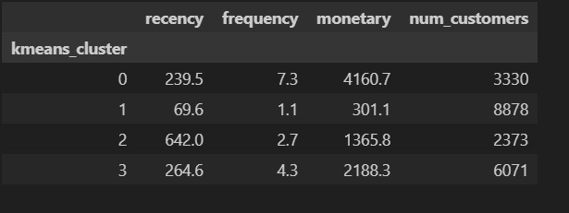
Conclusion
Customer Segmentation
By leveraging clustering techniques such as K-Means, we successfully segmented customers into four distinct groups based on purchasing behavior, shipping preferences, and order history.
Cluster 0: Loyal High-Value
Cluster 1: New/Low-Value
Cluster 2: inactive Mid-Spenders,
Cluster 3: Engaged Mid-Value
These analysis revealed clear patterns among different customer types:
customers Cluster 1 New/low value, Despite low individual value, this is the largest segment, representing a significant opportunity for growth if engaged properly.
These insights enable businesses to personalize marketing strategies, optimize shipping options.

Slide 34



Conclusion
Fraud Detection
To detect fraudulent activities, we applied machine learning techniques that analyzed customer payment methods, order frequency, and delivery behavior. The models identified outliers and suspicious patterns that deviated from normal purchasing behavior, such as sudden high-value orders or unusual shipping addresses.
By flagging these anomalies early, businesses can take proactive measures to investigate and prevent fraud, reducing potential revenue loss and maintaining customer trust. The system provides a scalable, data-driven framework that can continuously learn and adapt to new fraud patterns.

Slide 35

Conclusion
Sales Forecasting
Using time series analysis we forecasted future sales based on historical data, capturing seasonal trends, quarterly fluctuations, and regional demand variations. The predictive insights help businesses align inventory, plan marketing efforts, and optimize supply chain operations.
Accurate forecasting supports better decision-making by anticipating demand surges or slowdowns, thereby improving resource allocation, minimizing waste, and maximizing revenue potential.

Slide 36




THANK YOU!

Slide 37
QUESTIONS?

